Slide 1
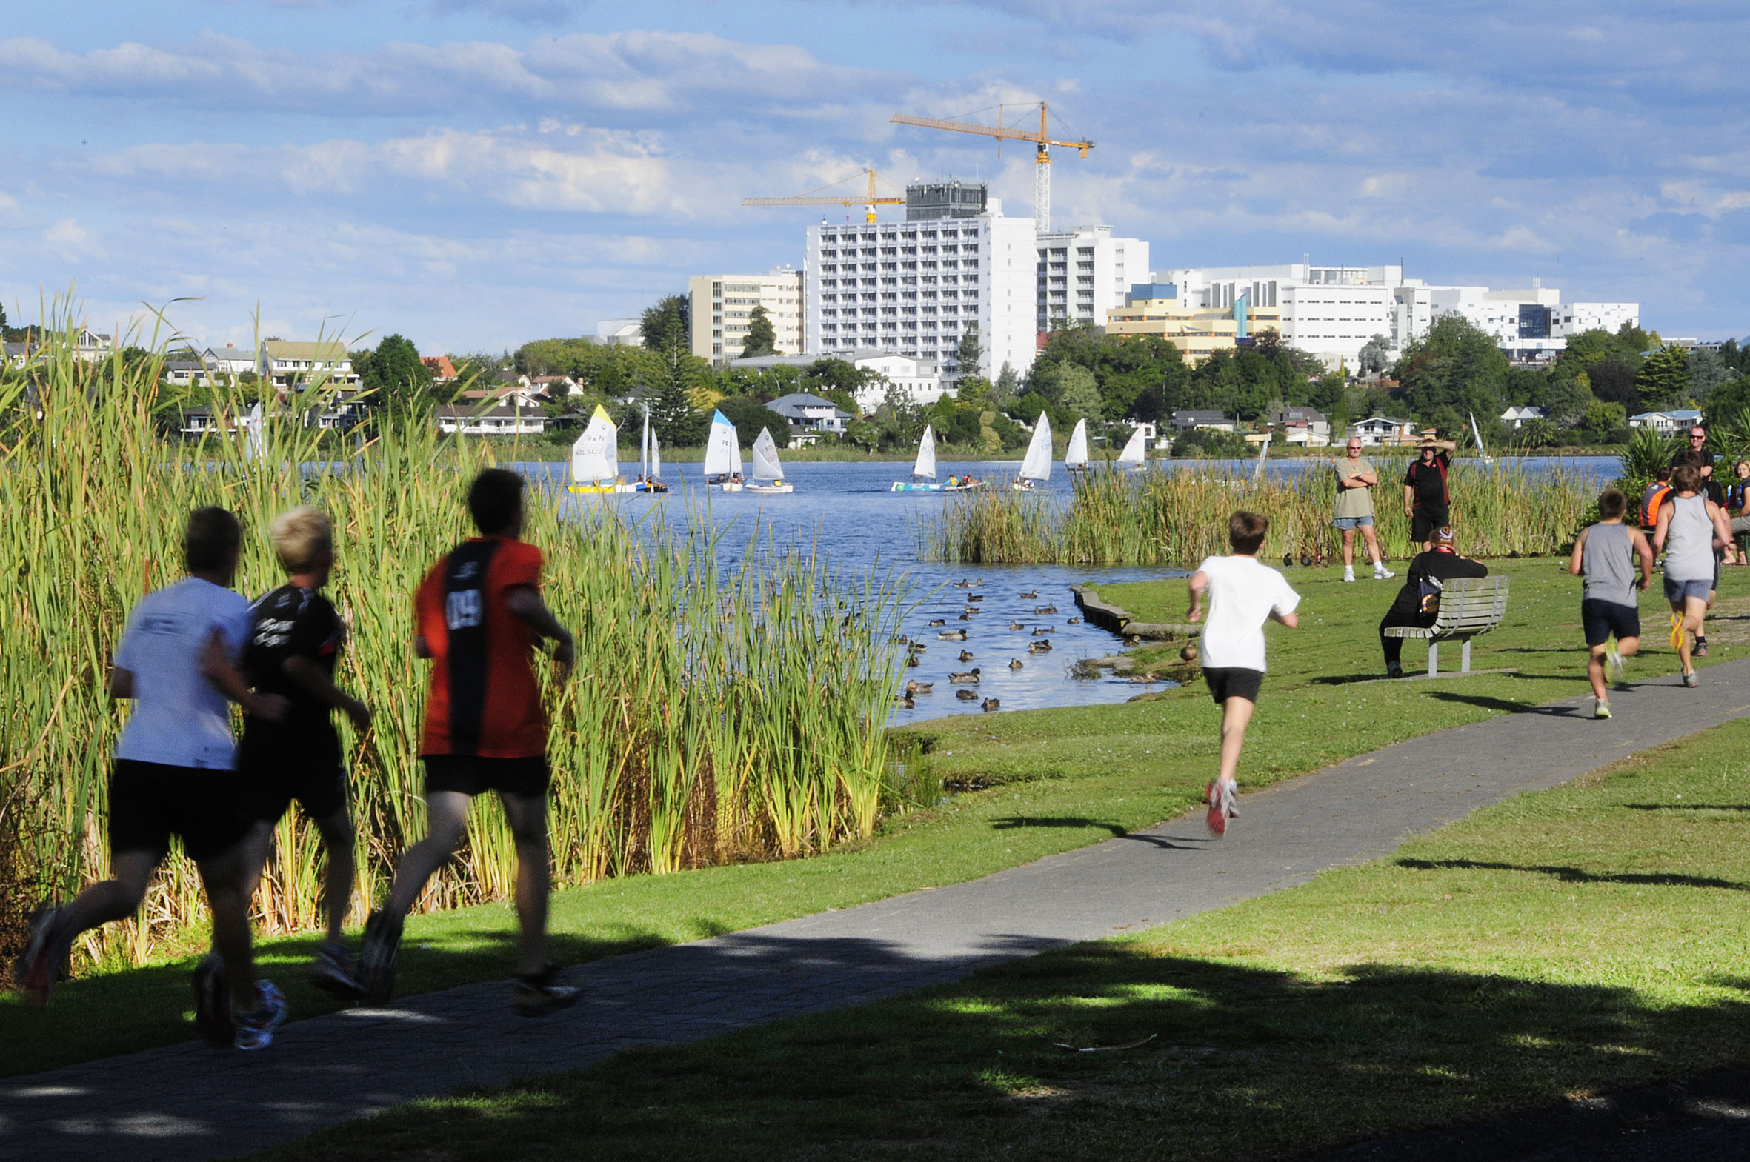
Welcome to Waikato DHB

Slide 2
Waikato DHB
The mighty Waikato
Waikato DHB Campus
The RMO Unit
Clinical Attachments for PGY1’s
PGY2 year at Waikato
Preference Selections
Recruitment Process

Slide 3
Waikato Fast Facts
Hamilton was crowned as the most beautiful large city 2020
Hamilton has 3 international sports venues: FMG Stadium, International Cricket ground at Seddon, Claudlands Events Centre
Population estimate is 169,500 (June 2019)
NZ European make up 3 quarters of the population with 19% Maaori
The city is home to 160 ethnicities making up about 20%
The climate is mild and moderate year round and rainfall keeps the city and surrounding areas very green
We are home of the Chiefs
There are many attractions to our Region !

Slide 4
Waikato DHB
Waikato Hospital is based in Hamilton but under the Waikato DHB there are other smaller hospital sites
We are around 600 bed hospital not including the 200 in Mental Health.
With 12 Community Based Attachment (CBA) sites
As a PGY1 you will work only at the Main Waikato Site
Waikato DHB offers well-structured and well-planned post-graduate training for PGY1 House Officers
There are many reasons why you would choose Waikato !

Slide 5
Waikato DHB – PGY1 Teaching
We provide protected Formal Education Course (FEC) teaching time weekly – three hours of protected training time weekly
Use senior doctors or advanced trainees who are all experts or advanced practitioners in their fields to present teaching topics
Support career development and have a dedicated education training unit for this

Slide 6
The RMO Support Service
What do we do ?
RMO Recruitment and Rostering
We have on staff upto 500 RMO’s at anytime
Coordinate PGY1 selection within the ACE process
Powhiri and Orientation for new RMO’s
Allocation of House Officer clinical attachments
Rostering
Medicine Roster – Registrars & House Officers
Surgical House Officer Roster,
Managing leave and the relief pools

Slide 7
Hospital Review
The RMO Unit will try their best to aid with any issues and items such as leave requests, claims are processed quickly
The RMO Lounge is large, has comfortable lazy boys, sky tv (including movies and sport) and computers. There is a kitchen with basic facilities and frozen meals are kept here for nights on call.
There are a number of sleep rooms with beds
Being a large hospital there are enough staff this means usually not having to give up too many of your evenings/weekends/nights

Slide 8
Clinical Attachments – PGY1
General Medicine
General Surgery
Cardiology
Haematology
Mental Health
Orthopaedics
Paediatric Surgery
Plastics
Rehabilitation
Respiratory
Urology

Slide 9
Selecting Preferences
Clinical Attachments
Please indicate in the first column your five most preferred attachments (1-5, with 1 = most preferred).
Ranking | Clinical Attachment
 | Cardiology
4 | General Medicine
5 | General Surgery
 | Haematology
 | Mental Health
1 | Orthopaedics
2 | Plastics
 | Rehabilitation
 | Respiratory
3 | Urology

Slide 10
Recruitment Process
Once ranking has completed and you have been matched to Waikato – we will make contact
All offers go out the same time nationally
We hire directly of the ACE talent pool for any candidates that withdraw or decline an offer with us.

Slide 11
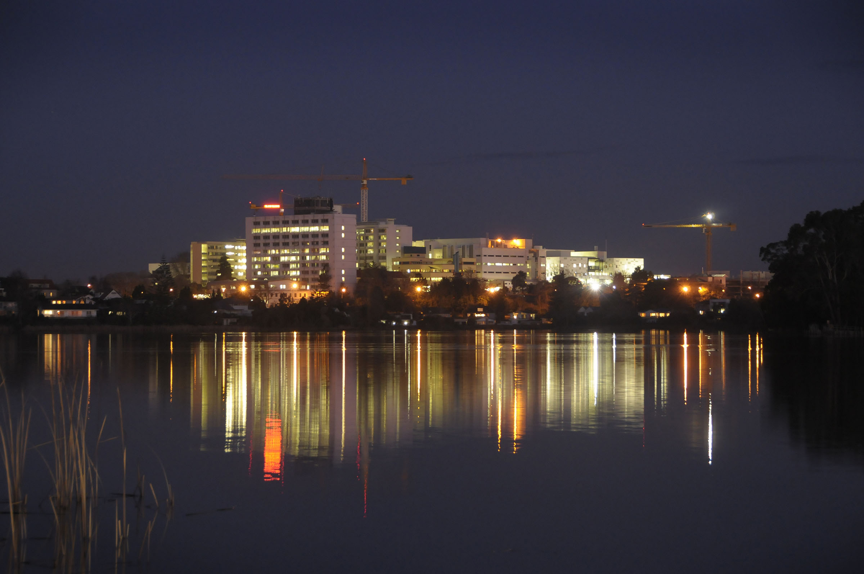
Come !! Join us here

