Slide 1
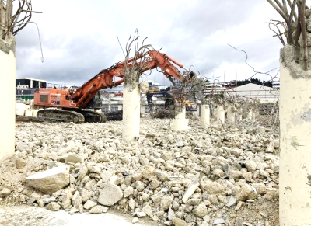
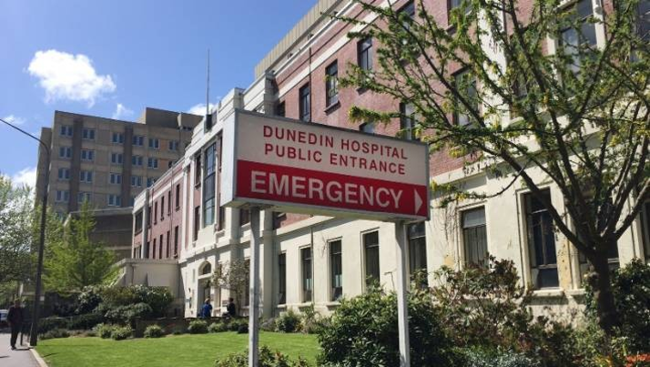
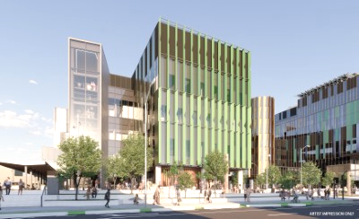
Dunedin Hospital
And some exciting changes ahead!

Slide 2
WELCOME AND INTRODUCTIONS
Dr Kathryn Forwood, Medical Director for Prevocational Education
Dr Brendan Arnold, Prevocational Educational Supervisor
Dr Kelsey McNabb, PGY1 house officer
Marlene Griffin, Team Leader, RMO Unit, Dunedin
Debbie Schaaf, RMO Advisor, RMO unit, Dunedin

Slide 3
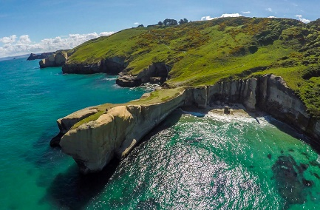
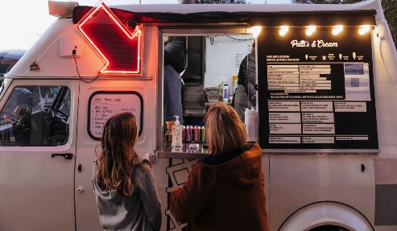
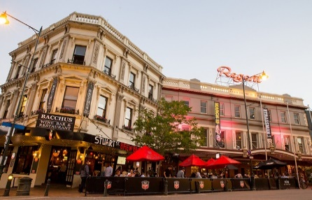
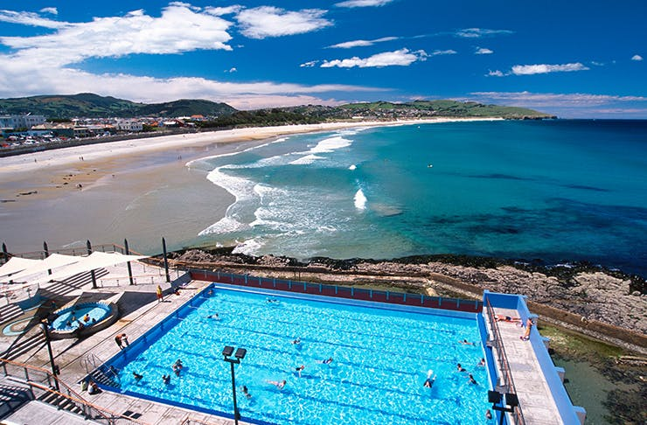
Why Dunedin?
Dunedin Hospital is a 400 bed tertiary hospital located in Central Dunedin serving the city of Dunedin and the wider Otago region.
Dunedin Hospital offers experiences in a wide range of specialities and sub specialties.
With hospitals small enough to give you hands-on specialist-led experience, yet big enough to learn through an internationally-renowned research partnership, your career opportunities are limitless. We’re looking for Doctors who want to level up, grow their areas of interest, and work with specialists who know their name.
Southern DHB has a strong collaborative relationship with the University of Otago making a number of teaching and research options possible for those keen to pursue their academic careers whilst completing their clinical work
Life outside of the hospital is just as opportunity-filled – there’s always an adventure waiting for you at the end of your shift. We’re surrounded by the dream combination of mountains, beaches and snow. Dunedin has some 30 beaches within 30 minutes’ drive from the city centre, and most have great surf.
In the city the activities are just as varied – being a student region there’s always something going on. This combination plus the lack of commute makes for a fantastic work life balance here.

Slide 4
First Year Runs
General Medicine
Cardiology
General Surgery
Urology
Orthopaedics
Psychiatry (Wakari)
Older Persons Health
Mental Health for Older People
Rehabilitation (Wakari)

Slide 5
Second Year Runs
O&G - 6 months
Paediatrics – 6 months
Emergency Medicine – 3 months
Gastroenterology, Haematology, Oncology, Renal, Respiratory
Neurosurgery, Neurology / Ophthalmology, Cardiothoracic Surgery, ENT, General Surgery Acutes
Internal Medicine Assessment Unit
Community Runs
Rotator runs

Slide 6
Types of Roster
Rosters vary across specialties, and are all templated, to give you an idea:
PGY1 ‘s work:
Long days – up to one per week
Weekends – approximately 2 -3 per quarter
No nights in 1st 6 months

Slide 7
Regular House Officer Teaching
Weekly teaching session on a Thursday (Protected)
Journal Club
Grand Rounds Weekly - organised by the University

Slide 8
Vocational Training Offered
PGY1s are allocated to runs that will provide for a broad and general experience allowing for sub specialisation in their second year
For PGY2+ Dunedin Hospital offers vocational training in the following specialties.
Each year we employ a good mix of training and non-training Registrars:
ED
Medicine
O&G
Paediatrics
Orthopaedics
General Surgery
Anaesthesia

Slide 9
PGY1 Representative
A day in the life of a House Officer here at Dunedin Hospital
(Kelsey McNabb, House Officer rep)

Slide 10
Application Process
Cover Letter
Reasons why you want to live and work in the Otago region
Family and Friends
Sporting or cultural involvements
Training opportunities
What we look for in your application
DHB Ranking
If you want to come to Dunedin Hospital, then preference our DHB first
Number of positions
The number of positions we have available for 2022 is 26
Contact
If able, make contact with our Medical Director Prevocational Educational, Brendan Arnold, Prevocational Educator Supervisor or the RMO Unit
References
References are very important to us
Ideally you will be required to submit 3 references
We prefer a variety of services/areas – however not compulsory
As recent as possible

Slide 11
Summary – Dunedin
Dunedin is a great place to start your PGY1 year, we have a wide range of specialities for you to work in, our RMO office has an open door policy, the relationship with the University is very strong and there is great support.
Make sure your application is lodged by 8 July at 12 noon
Choose Dunedin as your 1st choice
Make contact with Kathryn Forwood, Brendan Arnold, Debbie Schaaf or Marlene Griffin
Cover letter to include reasons why you want to be in Dunedin
3 references required

Slide 12
Southern District Health Board Values

Slide 13
Questions and Answers
While we work through any questions you may have, please enjoy some pictures of what Dunedin has on offer …..
Ōtepoti | Dunedin New Zealand official website (dunedinnz.com)

